Slide 1
EECE 301
Signals & Systems
Prof. Mark Fowler
Note Set #2
What are Continuous-Time Signals???

Slide 2
Continuous-Time Signal
Continuous Time (C-T) Signal: A C-T signal is defined on the continuum of
f(t) for t ∈ ℜ
f(t)
time values. That is:
Time-Varying Voltage, Current, etc.
Real # Line
t
Unit Step Function u(t)
_{u(t) =} ⎧1, t ≥ 0
u(t)
⎨
1
. . .
⎩0, t < 0
. . .
t
Note: A step of height A can be made from Au(t)

Slide 3
The unit step signal can model the act of switching on a DC
source…
R
t = 0
+
C
V_{s}
–
R
V_{s}u(t)
+
C
–

Slide 4
Unit Ramp Function r(t)
r(t) 1
⎧t, t ≥ 0
Unit slope
r(t) = ⎨
. . .
t
⎩0, t < 0
1
Note: A ramp with slope m can be made from: mr(t)
_{mr(t) =} ⎧mt, t ≥ 0
⎨
⎩0, t < 0

Slide 5
Time Shifting Signals
Time shifting is an operation on a signal that shows up in many areas of signals and systems:
Time delays due to propagation of signals
acoustic signals propagate at the speed of sound
radio signals propagate at the speed of light
Time delays can be used to “build” complicated signals
We’ll see this later
Time Shift: If you know x(t), what does x(t – t₀) look like? For example… If t₀ = 2:
x(0 – 2) = x(–2) x(1 – 2) = x(–1)
At t = 0, x(t – 2) takes the value of x(t) at t = –2
At t = 1, x(t – 2) takes the value of x(t) at t = –1

Slide 6
Example of Time Shift of the Unit Step u(t):
u(t)
1
. . .
-2 -1
1 2 3 4
t
u(t-2)
1
. . .
-2 -1
1 2 3 4
t
u(t+0.5) 1
General View:
. . .
x(t ± t₀) for t₀ > 0
“+t₀” gives Left shift (Advance) “–t₀” gives Right shift (Delay)
-2 -1
1 2 3 4
t

Slide 7
The Impulse Function
Other Names: Delta Function, Dirac Delta Function
One of the most important functions for understanding systems!! Ironically…it does not exist in practice!!
⇒ It is a theoretical tool used to understand what is important to know about systems!
But… it leads to ideas that are used all the time in practice!! There are three views we’ll take of the delta function:
Infinite height Zero width Unit area
Rough View: a pulse with:
“A really narrow, really tall pulse that has unit area”

Slide 8
Slightly Less-Rough View: Limit of pulse with width ε and height 1/ε
1
ε
So as ε gets smaller the pulse gets higher and
narrower but always has area of 1…
−ε
2
ε
2
t
In the limit as ε gets smaller it “becomes” the
delta function
Precise Idea: δ(t) is defined by its behavior inside an integral:
The delta function δ(t) is defined as something that satisfies the following two
conditions:
δ (t) = 0,
for any t ≠ 0
ε
∫δ (t)dt = 1,
−ε
for any ε > 0

Slide 9
Showing Delta Function on a Plot:
We show δ(t) on a plot using an arrow…
(conveys infinite height and zero width)
This is the vertical axis…
δ(t)
Caution… this is NOT the vertical
axis… it is the delta function!!!
t
δ(t - T)
A time shift just changes where the delta is “located”
T
t

Slide 10
∫ f (t)δ (t − t₀ )dt = f (t₀ )
t₀ −ε
The Sifting Property is the most important property of δ(t):
t₀ +ε
∀ε > 0
f(t)
Integrating the product of f(t)
f(t )
0
f(t )
and δ(t – t )
0
o
t₀
returns a single number… the value of f(t) at the “location” of the shifted delta function
t
δ(t- t₀)
t₀
t
As long as the integral’s limits surround the “location” of the delta… otherwise it returns zero
10/16

Slide 11
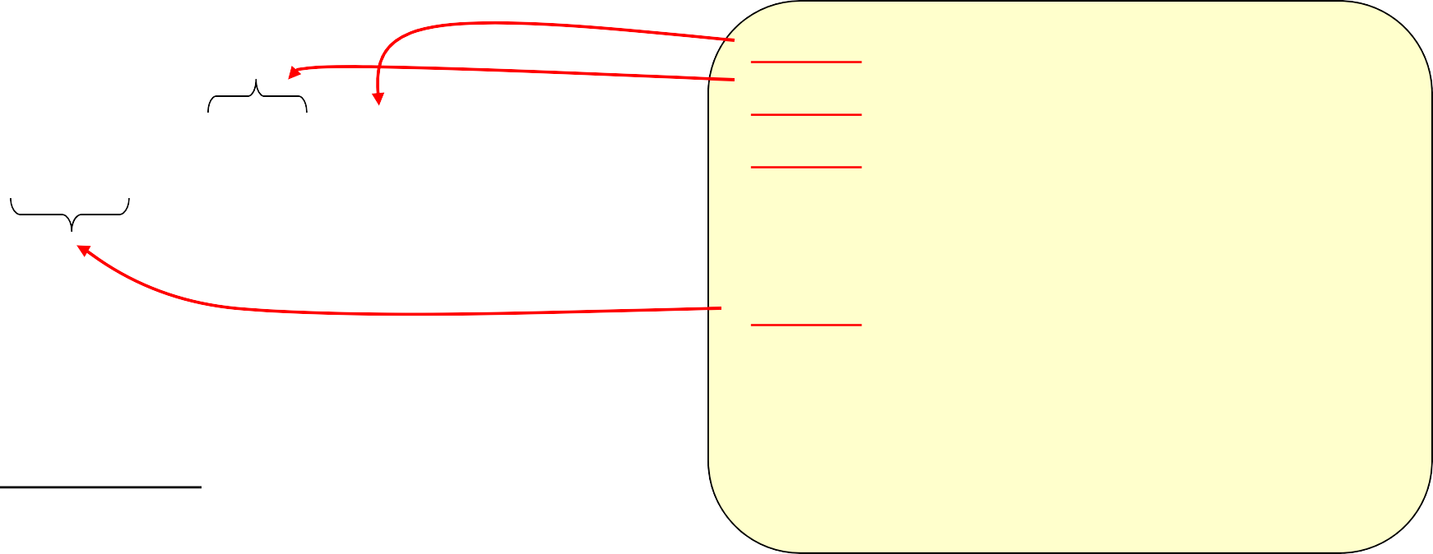
Steps for applying sifting property:
Step 1: Find variable of integration Step 2: Find the argument of δ(•) Step 3: Find the value of the variable of integration that causes the argument of δ(•) to go to zero. Step 4: If value in Step 3 lies inside limits of integration… Take everything that is multiplying δ(•) and evaluate it at the value found in step 3; Otherwise… “return” zero
Step 1: t Step 2: t – 1 Step 3: t – 1 = 0 ⇒ t = 1 Step 4: t = 1 lies in [–4,7] so
evaluate… sin(π×1) = sin(π) = 0
t +ε
0
∫ f (t)δ (t − t₀ )dt = f (t₀ )
t₀ −ε
Example:
7
∫ sin(πt)δ (t − 1)dt = ?
−4
δ (t − 1)
sin(πt)
7
∫ sin(πt)δ (t − 1)dt = 0
−4
1 2 3
t
11/16

Slide 12
Periodic Signals
Periodic signals are important because many human-made signals are periodic. Most test signals used in testing circuits are periodic signals (e.g., sine waves, square waves, etc.)
A Continuous-Time signal x(t) is periodic with period T
if: x(t + T) = x(t)
∀t
. . .
x(t)
T
. . .
x(t)
x(t + T)
t
Fundamental period = smallest such T
When we say “Period” we almost always mean “Fundamental Period”
12/16

Slide 13
Power and Energy of Signals
Imagine that signal x(t) is a voltage.
If x(t) drops across resistance R, the instantaneous power is
x² (t)
p(t) =
R
Sometimes we don’t know what R is there so we “normalize” this by ignoring the R
value:
p_{N} (t) = x (t)
2
Once we have a specific R we can always un-normalize via ^{pN (t)}
R
(In “Signals & Systems” we will drop the N subscript)
Recall: power = energy per unit time
(1 W = 1 J/s)
⇒ p(t) = ^{dE(t)}
⇒ dE(t) = x² (t)dt
differential increment of energy
dt
⇒ Energy in one period =
∫
T +t
0
dE(t) =
∫
T +t
0
2
x (t)dt
t₀
t₀
∞
Note… if x(t) is not periodic its energy may be finite if it falls off fast enough at its “ends”
13/16
The Total Energy
=
∫
x² (t)dt
−∞
= ∞ for a periodic signal

Slide 14
Recall: power = energy per unit time
Average power over one period =
Energy in One Period
T
1
T
Often just called “Average Power”
P =
∫
T +t
0
2
x (t)dt
t₀
For periodic signals we use the average power as measure of the “size” of a signal.
The Average Power of practical periodic signals is finite and non-zero. (Recall that the total energy of a periodic signal is infinite.)
14/16

Slide 15
Rectangular Pulse Function: p_{τ}(t)
Subscript specifies the pulse width
p (t)
1
τ
-τ/2 τ/2
t
We can build a Rectangular Pulse from Unit Step Functions:
p_{τ}(t) = u(t + τ/2) – u(t – τ/2)
u(t + τ/2)
This is helpful because we will have lots of results that apply to the step function
1
-τ/2
t
u(t - τ/2)
1
-τ/2
τ/2
t
0 – 0 = 0
1 – 0 = 1
1 – 1 = 0
15/16

Slide 16
Building Signals with Pulses: shifted pulses are used to mathematically “turn other functions on and off”.
g(t) = 0.5t + 1
2
1
Continues up forever
This
Times This
Continues down forever
1 2
Delay by 1
t
p₂(t - 1)
1
Width of 2
2
t
Multiplying By One “Turns On” g(t)
Multiplying By Zero “Turns Off” g(t)
3
2
1
Gives
f(t) = (0.5t + 1)p₂(t - 1)
This
1 2
t
16/16

